Slide 1
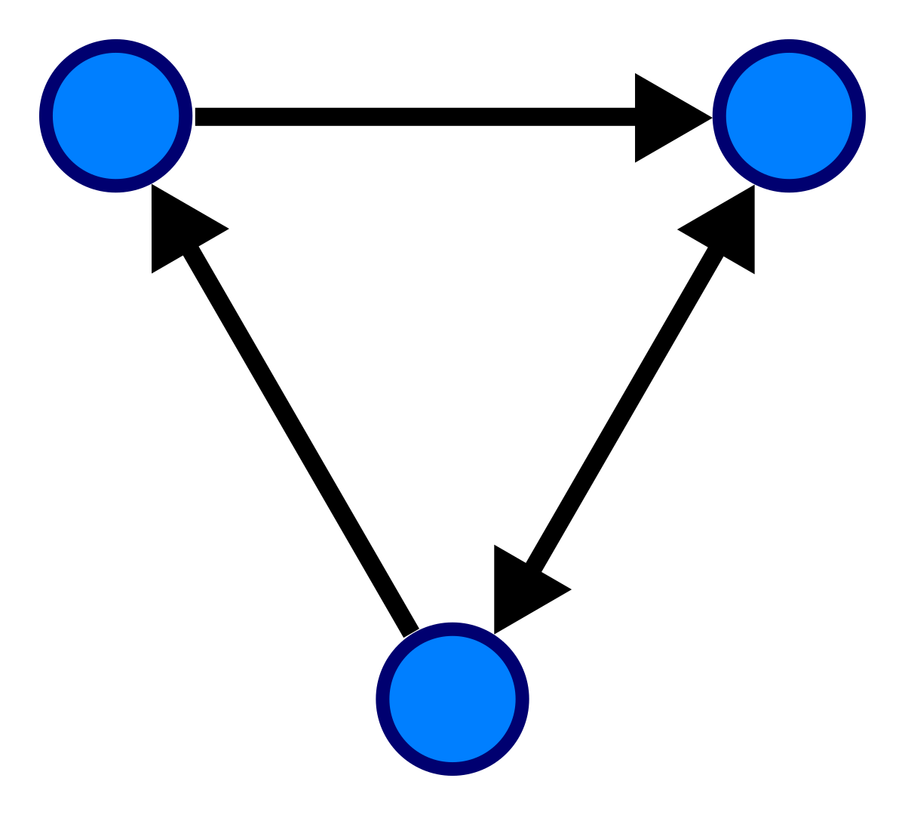
CourseCompass
ABM for Simulating Course Flow with Prerequisites
Parth Patel

Slide 2
Quick Description
This agent based model focuses on students working their way through a curriculum where to move to the next class all the prereqs of the previous class must be met.
I have chosen Temple’s Computer Science curriculum to be the base model for this since I know it the best.
The aim here is to investigate the behaviors of students moving through a curriculum.

Slide 3
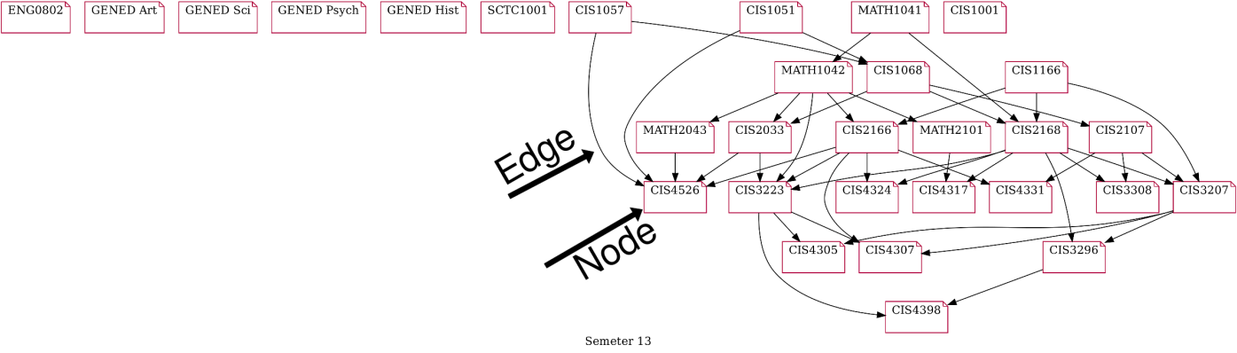
Representation of the Problem
The curriculum is represented by a graph with nodes and edges. The nodes are the classes and the edges are the connections between them. A prerequisite relation is relayed by an arrow. For example MATH1041 is a prerequisite of MATH1042.
In Graph Theory, a topological traversal (certain method/order of visiting nodes) gives us an order of moving from class to class without violating prerequisite relation relations

Slide 4

Agents: Students
Tracking Attributes
has_finished
current_semester
curr_credit_count
Decision Altering Attributes
courses_taken
courses_currently_taking
courses_failed
past_grades
course_plan: series of courses they wish to take, they vary per student
The decision altering attributes are the ones used to choose classes.

Slide 5

Environment: Courses
Attributes
Name
Credit_count
Class_size
One of the Agent-Agent interactions as not all agents who wish to take a class can.
prerequisites/requirements to take this class
course_type
a marker for determining which requirements a class meets

Slide 6

Environment: Scheduler
Students use the Scheduler to sign up for classes. The scheduler validates each student and verifies prerequisite information before sign up. It also periodically checks if a student can graduate.
Note: The scheduler order changes each timestep so no one student gets access to class first each time.

Slide 7
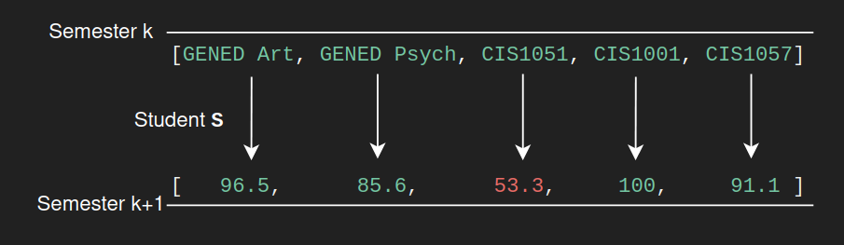

Time Stepping
At each timestep classes are assigned:
Then before the next semester starts, grades are assigned. For this model I have chosen the passing cut off to be 63 points.

Slide 8
How Can we assign grades?

Slide 9
Grading Method 1:
Random grades are assigned under a normal distribution with the average (μ) being 75 and the standard deviation (σ) being 10.
It seems that if grades follow a normal distribution, so do the amount of semesters required to graduate.
Mathematically, the low skew on most of these histograms imply a lot of values lie near the mean and mimic a normal curve.

Slide 10
Grading Method 2: History Based Grading
Random grades are assigned under a normal distribution with the average (μ) being 75 and the standard deviation (σ) being 10 when a class has no prerequisites. If a class does, the mean (μ) is replaced by the average on what they received before in that class.
The new grading policy seems to have had a drastic effect on the distribution. This is because once you receive a good grade in a class it is used again when calculating your grade for the future. However the reverse is also true. Having a bad start can also slow you down as shown by the higher skew: more numbers lie on the far ends of the spectrum.

Slide 11
Which one is more realistic?
Experts on the internet think that there is no shape or curve that fits the performance of students in any classroom however between these two it does seem more probable that compounded instances of success would imply future success.
An issue of the History Based system is that it punishes students who wish to complete more classes as lower grades initially will drag out their experience.
One thing to note is that the History based grading method had a lower average semester value.
History Based
Random

Slide 12
Visualizing Each Timestep
In this Graph, arrows (edges) represent the prerequisites.
Notice CIS4526 (middle) has many prerequisites.
Notice also that no siblings are prereqs. An agent must move down to graduate.

Slide 13
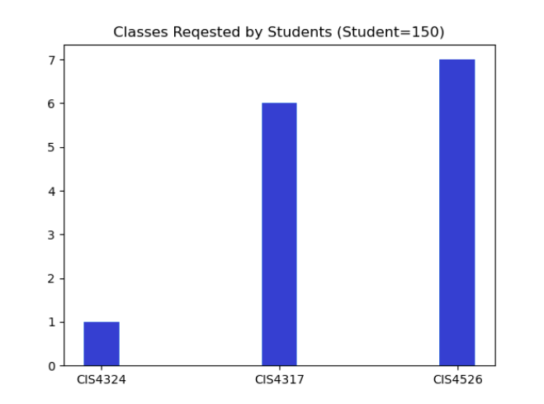
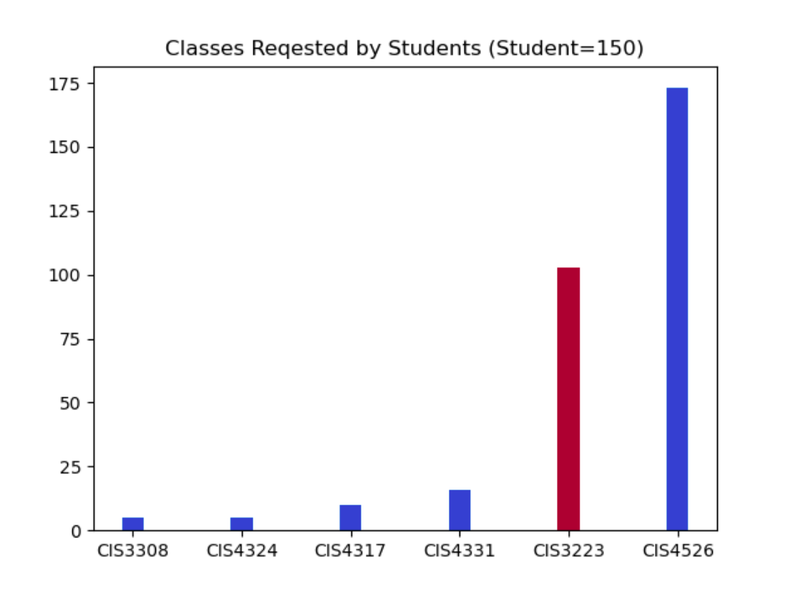
Emergent Behavior: Finding Bottlenecks
I artificially reduced the seats in CIS 3223 from 100 to 70 and reduced CIS4526 from 45 to 30 seats.
Since each agent has a course plan and CIS3223 is a required course the mass of agents trying to take the course becomes waitlisted. Evidently modeling this behavior can help find where I the curriculum there exist bottlenecks.
I have marked major classes in red.

Slide 14
Data Organization and Technologies Used
Course Information and Major Graduation Requirements were kept in a JSON (Javascript Object Notation) File. Below are two instances of records.
"requirements": {
"major - intro": 1,
"major - electives": 3,
"gened_gen": 1,
"gened_art": 1,
"gened_sci": 1,
"gened_human": 1,
"gened_hist": 1
},
{
"code": "CIS4526",
"name": "Foundations of Machine Learning",
"creditno": 3,
"classsize": 30,
"prerequisites": ["MATH2043", "CIS2166", "CIS2033"],
"coursetype": "major - electives",
"requirements": ["major - intro"]
},
Matplotlib (Charts and Graphs)
Networkx and PyGraphViz (Graph Generation)
Numpy, Scipy (Statistical Calculations)
Technologies Used ->

Slide 15
Modeling Difficulties
Representing the ‘or' prerequisite relationship
Many classes want one class of a a list
This created issues in course planning and graph drawing.
Finding Existing literature on this topic
While modeling is an active research topic modeling classes is not it seems
Data on college grades is kept very private
Finding a good arrangement of class sizes to work with. In the end I mildly copied the ratios on the temple bulletin to accommodate 150 students.

